Slide 1
Compute cosine similarity of memory using Wikipedia and Reddit respectively
Rerun the TSNE plot with respect to the hidden vectors of the MLP classifier
Study a method of visualizing attention weight (seaborn heatmap)

Slide 2
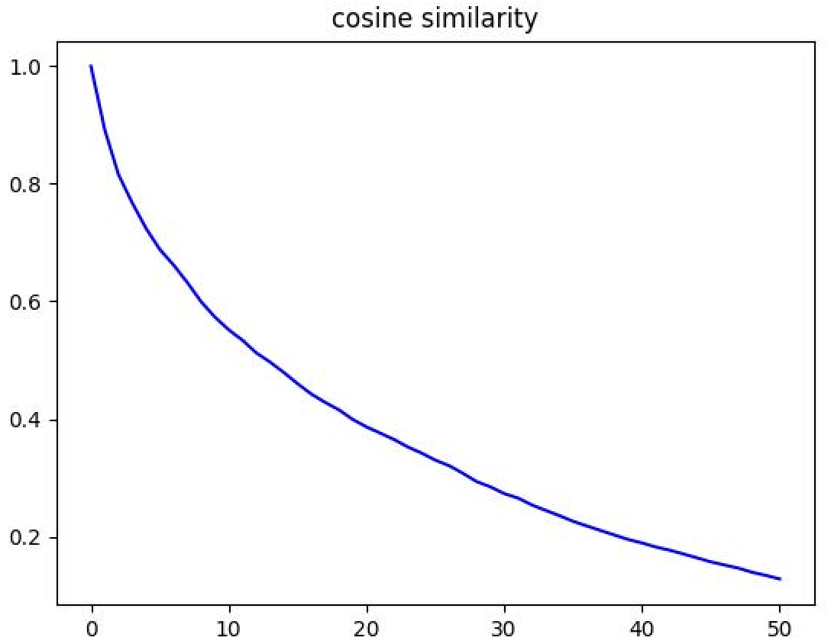
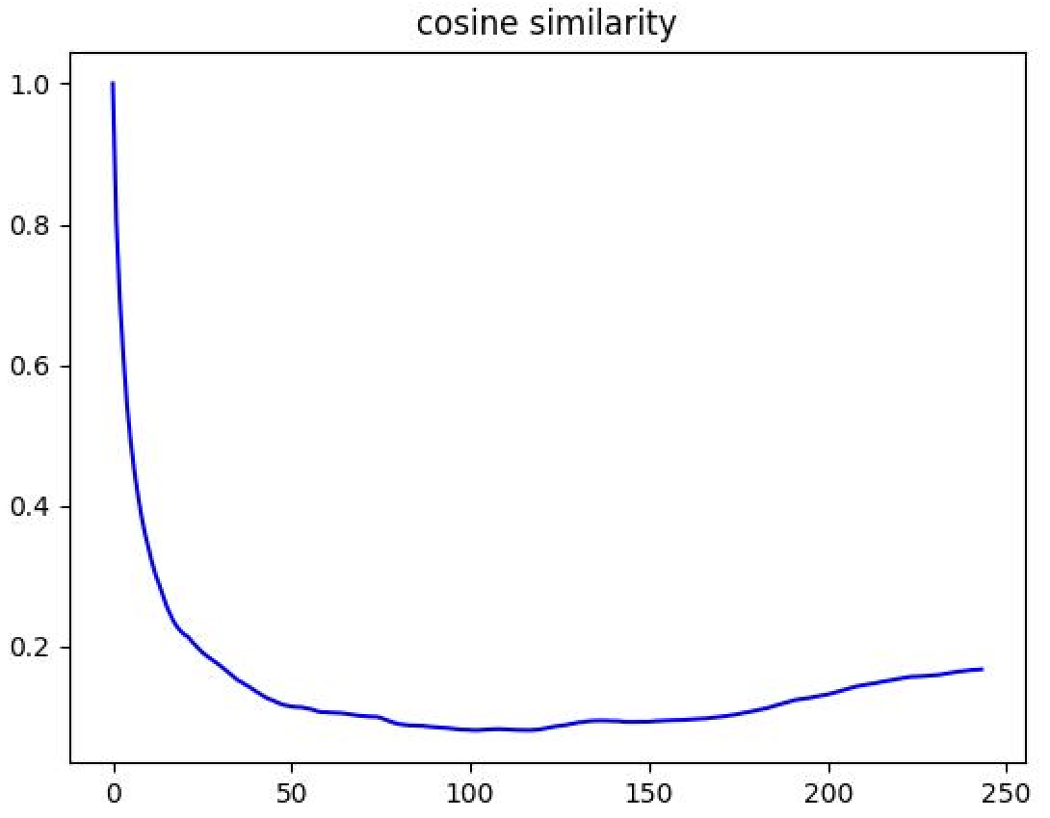
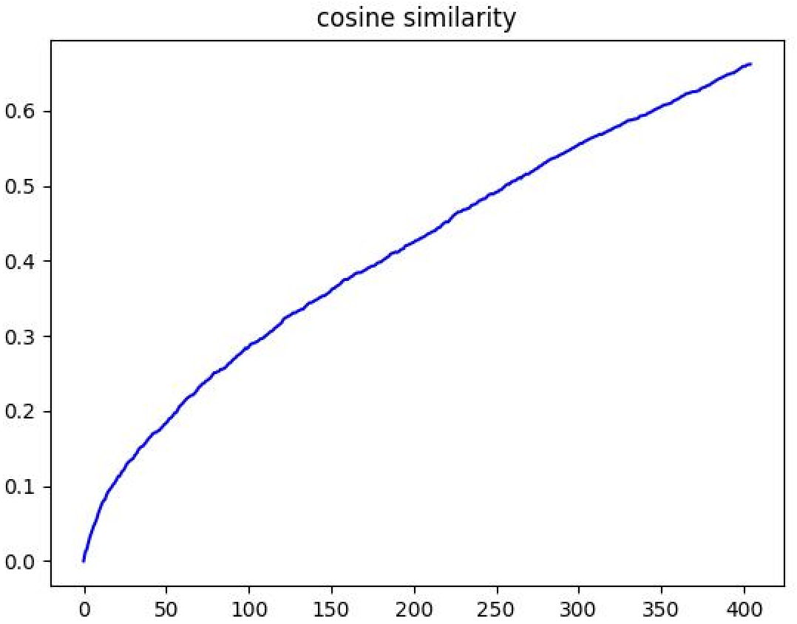
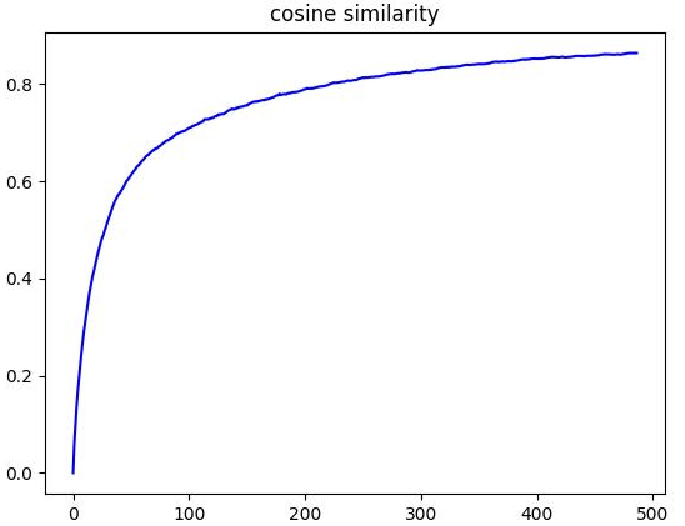
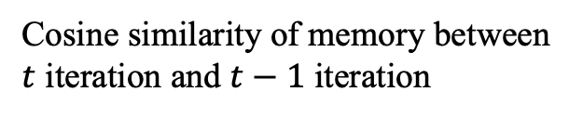
Compute cosine similarity of memory
Wikipedia
Reddit
Cosine similarity of each embedding in memory in each iteration
[0,0,0
1,2,3
0,0,0
0,0,0]
[0,0,0
1,2,3
3,4,5
0,0,0]
Cosine similarity of memory between $t$ iteration and $t−1$ iteration

Slide 3
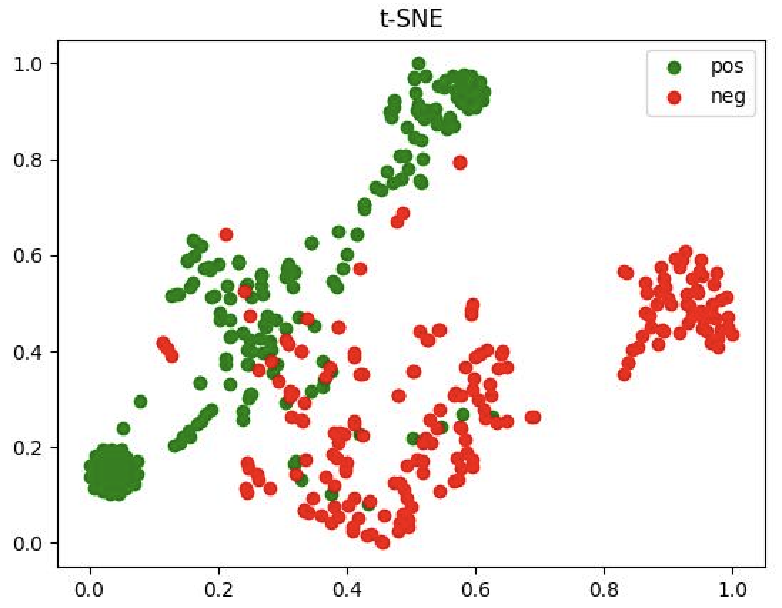
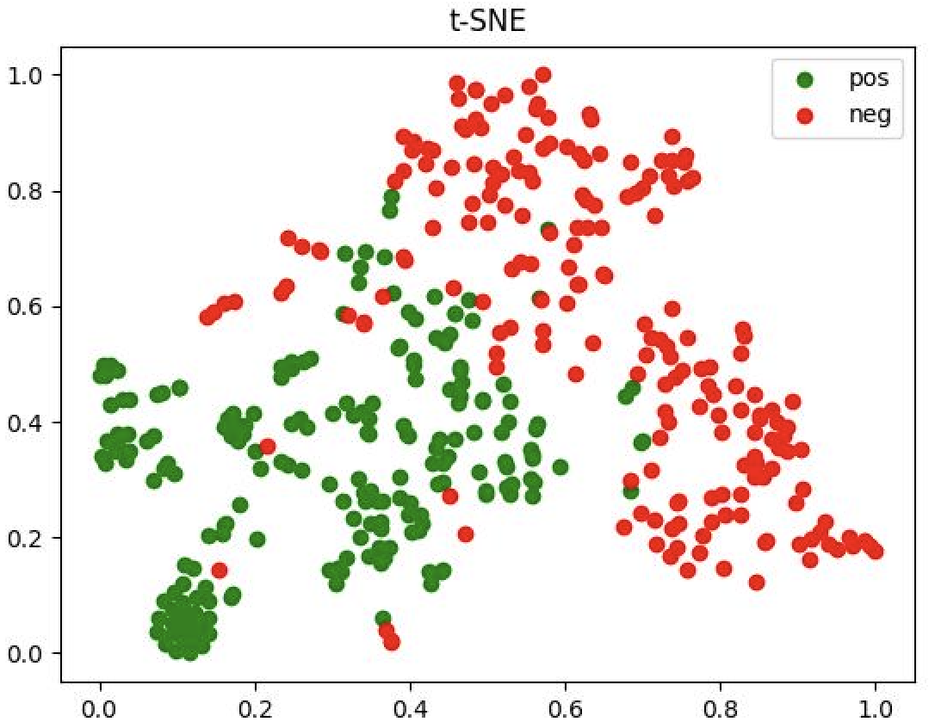
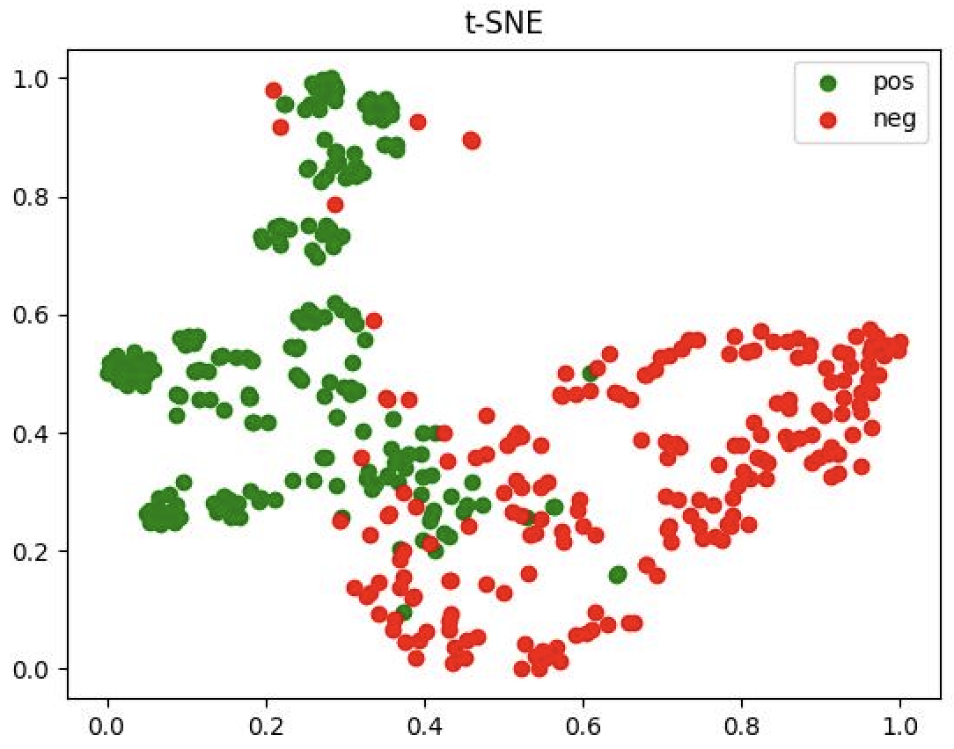
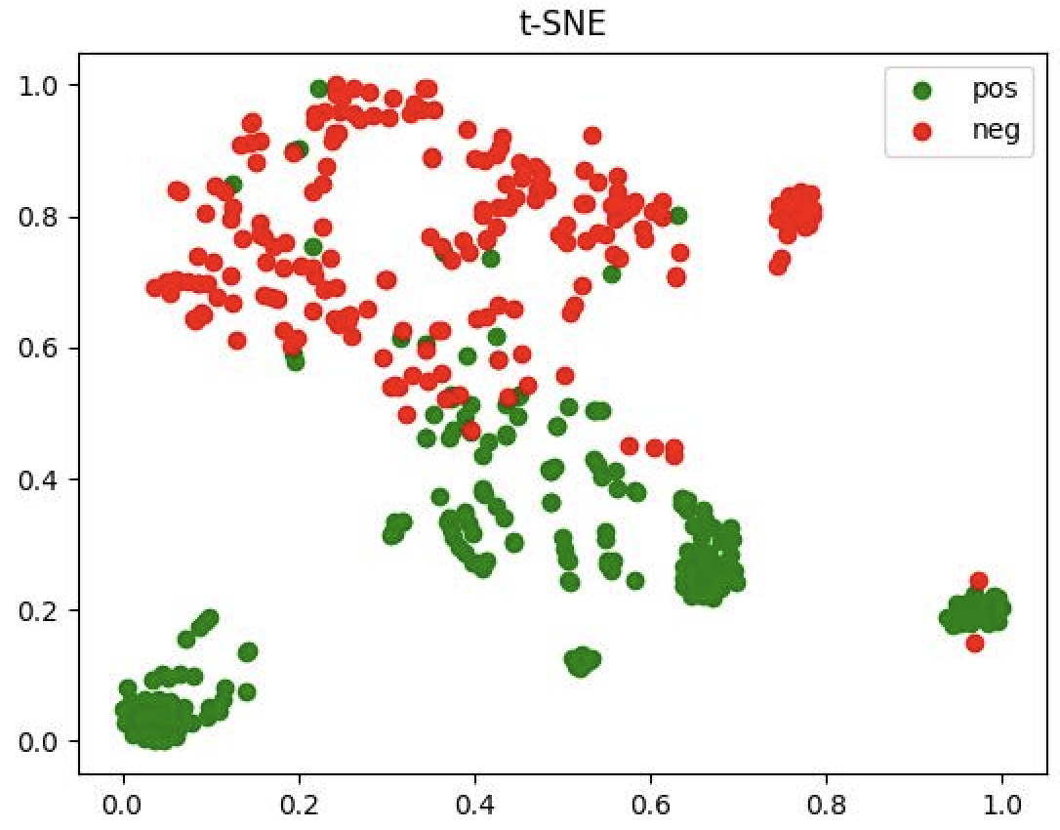
TSNE plot
Green-positive
Red-negative
Transductive
Inductive

